Slide 1
Working with UF/IFAS Extension in Blue Skies & Beyond
Panelists
Dr. Christa Court, Associate Professor, UF/IFAS FRE Department. State Extension Specialist & Director of the UF/IFAS Economic Impact Analysis Program.
Mr. David Outerbridge, Director, UF/IFAS Extension Lee County and Sustainable Food Systems & Natural Resources Educator.
Moderator
Saqib Mukhtar, UF/IFAS Extension
Professor and Associate Dean
SART Planning Workshop
May 28-30, 2025
St. Pete Beach, FL

Slide 2
What is Extension?

Slide 3
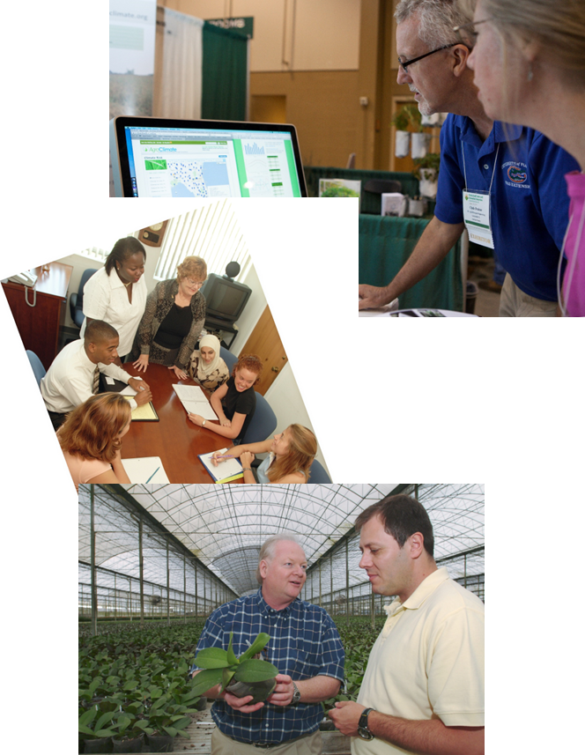
Cooperative Extension is a collaboration among local, state & federal governments.
Extension is about building relationships with colleagues and clientele to assess needs
We extend research-based knowledge that connects educational institutions with communities to solve critical individual and group needs
Our success is measured through positive change in Social, Economic & Environmental (SEE) conditions

Slide 4

We develop needs-based programs to disseminate science & research vetted unbiased information & knowledge in agriculture, natural resources, youth development and human sciences for positive social, economic, environmental and health impacts.
Notes:
UF/IFAS is a federal, state and local government partnership dedicated to develop knowledge in agriculture, human and natural resources, and the life sciences, and to make that knowledge accessible to sustain and enhance the quality of human life.

Slide 5
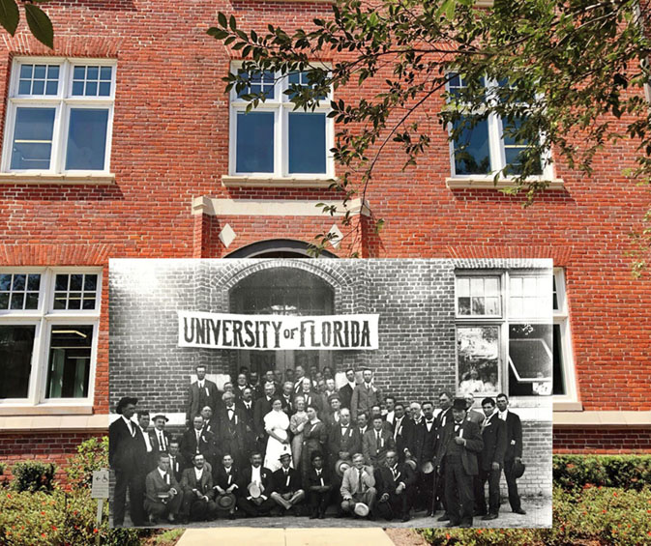
The Florida Agricultural College was established in Lake City in 1883; named the University of Florida in 1903; and then moved to Gainesville in 1906
Land Grant Institution (LGI) Morrill Acts of 1862 & 1890, & Equity in Educational-Land Grant Act of 1994
Cooperative Extension in the USA is 111 years old
106 LGIs do Extension
Newell Hall- The 2nd Annual Citrus Seminar at the Agriculture Experiment Station (Newell Hall) in 1911. Source: UF Then and Now Website https://www.dmarlin.com/uf-then-now/series3/
Notes:
In 1905, the state legislature passed the Buckman Act which established the Florida Female College in Tallahassee and moved the University of Florida to Gainesville. Classes began in Gainesville in 1906, and the university was divided into five schools, including the School of Agriculture. In 1910, the school became a college and J. J. Vernon became the first dean. By 1915, the office of the dean of the college, the director of the Agricultural Experiment Station and director of Agricultural Extension were combined and the head of all three was P. H. Rolfs.

Slide 6
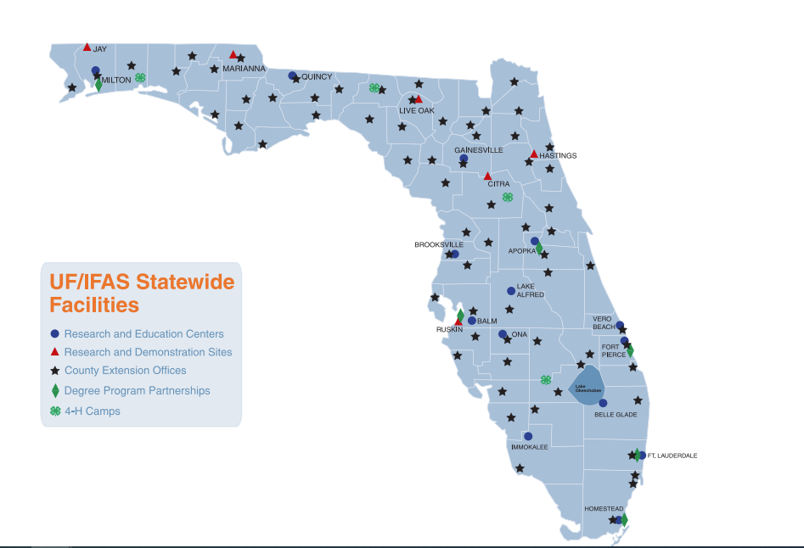
UF/IFAS Extension
Research & Education Centers
Citrus REC - Lake Alfred
Everglades REC - Belle Glade
Florida Medical Entomology Lab - Vero Beach
Fort Lauderdale REC -
Gulf Coast REC - Balm
Indian River REC - Fort Pierce
Mid-Florida REC - Apopka
North Florida REC - Quincy, Marianna, Live Oak
Range Cattle REC - Ona
Southwest Florida REC - Immokalee
Tropical REC - Homestead
West Florida REC - Jay
5 R&D/AEC Sites
Hastings Agricultural Extension Center – Hastings
Nature Coast Biological Station - Cedar Key
Ordway-Swisher Biological Station - Melrose
Plant Science Research and Education Unit – Citra
Tropical Aquaculture Laboratory - Ruskin

Slide 7
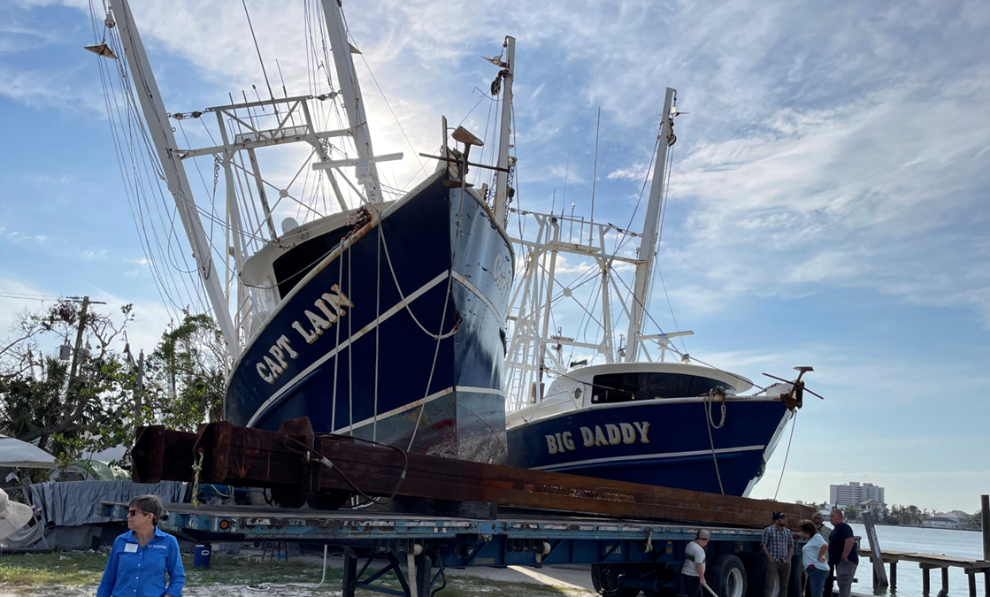
We build relationship and trust with citizens of Florida to assist them during Blue Skies & Beyond.
September 23, 2022-Hurricane Ian Devastates Shrimp Industry in SW Florida with 16-18 ft surge

Slide 8
Panelist Questions
1. Christa and David, Briefly, what are your expertise and how do you serve IFAS Extension?
2. David, as a Director and Extension Agent, how do you assist your clientele before, immediately after and several weeks & months after a disaster?
3. Christa-as the Director of UF/IFAS Economic Impact Analysis Program and Extension Specialist how do you train Extension faculty to assess disaster damages and develop preliminary and final Ag and Natural Resources loss estimates?

Slide 9
Panelist Questions
3. Christa & David, from your vantage point & experiences in Florida,
-What are the greatest challenges after a major disaster?
-What are your clients and stakeholders (define) long-term needs post disaster?
-How can effective collaborations with partners and availability of technology and other resources improve meeting challenges and needs?

Slide 10
Thank you!

